Slide 1
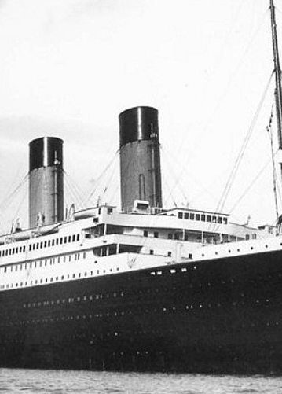
TITANIC SURVIVOR PREDICTION
Submitted by:
Virendra Verma
Submitted to:
Prof . Alka Singh

Slide 2
TABLE OF CONTENT
INTRODUCTION
PROBLEM STATEMENT
OBJECTIVE
FEASIBILITY STUDY
HARDWARE REQUIREMENT
SOFTWARE REQUIREMENT
TECHNOLOGIES REQUIRED
DATA VISULIZATION
TRAINING DATA
COMPARING MODELS
REFERENCES.

Slide 3
INTRODUCTION
The RMS Titanic was a British passenger liner that struck an iceberg on her maiden voyage and sank, taking the lives of more than 1500 passengers. We are interested in predicting the survival probability for a given passenger. There are many factors which played into which passengers made it into lifeboats and which passengers did not, most notably gender and class assignment. Our purpose is to find a conclusion using different predicting models by the data given a sample of 342 survivors and find if this hypothesis is true or not.

Slide 4
PROBLEM STATEMENT
Hypothesis: Certain sources claim that the survivors belonged to one of the following categories- Women, Children and/or Upper Class
Our problem to confirm if this hypothesis is true or not using the given sample of 342 survivors data and derive conclusions using different models in R

Slide 5
OBJECTIVE
Need to predict the probability of the survival based on the data available on various machine learning algorithms.
Compare some machine learning algorithms on the train.csv dataset.
Check and Select the important attribute for prediction.

Slide 6
FEASIBILITY STUDY
Feasibility of a system means ensuring that the system, which we are going to implement, is efficient and adorable.
There are three major areas which are to be taken in consideration.
Economic feasibility: Development of this application is highly economically feasible. It is free to use.
Technical feasibility: The technical requirement for the system is economic. The current project is feasible because it can run on any computer once converted into executable file, and hence it does not require any additional hardware or software.
Operational feasibility: It is simple and easy to use. User require no special training for operating the system.

Slide 7
HARDWARE REQUIREMENT
This system doesn’t require any hardware interface . The one used here is monitor, keyboard and mouse.
The system should have these hardware requirements:
Processor – 64 bit distribution capable of running 32 bit applications.
Keyboard – 104 keys
RAM – 3 GB minimum, 8 GB RAM recommended.
Monitor – 14’’ VGA COLOR
Mouse – Logitech Serial Mouse
Memory – 512 GB or above
Hard Disk – 10 GB or above.
Disk Space – 2 GB of available disk space minimum.

Slide 8
SOFTWARE REQUIREMENT
TOOL USED :
Jupyter Notebook
LIBRARY USED :
Analyzing: Numpy, Pandas, Sci-kit Learn
Visualization: Matplotlib, Seaborn
Prediction models: Decesion Tree, Random Forest Classifier, GaussianNB,
Kneighbors Classifier, Logistic Regression, SVM

Slide 9
TECHNOLOGIES REQUIRED
PYTHON :- Python is a general purpose and high level programming language. We can use Python for developing desktop GUI applications, websites and web applications. Also, Python, as a HLL, allows you to focus on core functionality of the application by taking care of common programming tasks. The simple syntax rules of the programming language further makes it easier for us to keep the code base readable and application maintainable. The syntax rules of Python allow you to express concepts without writing additional code.
MACHINE LEARNING :- Machine learning is an application of artificial intelligence (AI) that provides systems the ability to automatically learn and improve from experience without being explicitly programmed. Machine learning focuses on the development of computer programs that can access data and use it learn for themselves. The process of learning begins with observations or data, such as examples, direct experience, or instruction, in order to look for patterns in data and make better decisions in the future based on the examples that we provide. The primary aim is to allow the computers learn automatically without human intervention or assistance and adjust actions accordingly.

Slide 10
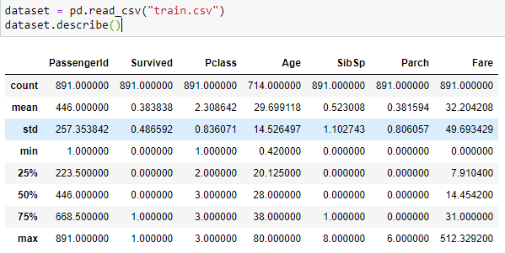
DATA VISUALIZATION
Analysing Data
From this data, we get that there are 891 total rows with there mean, min, and max values to visualize the data.

Slide 11
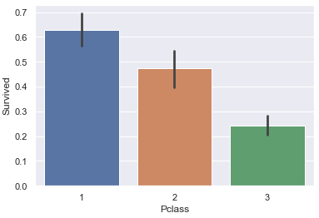
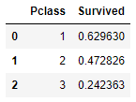
DATA VISUALIZATION
Comparing Pclass with Survived

Slide 12
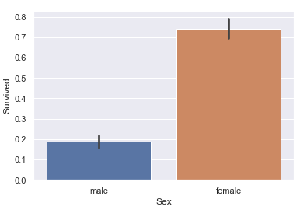

DATA VISUALIZATION
Comparing Sex with Survived

Slide 13
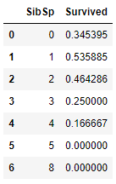
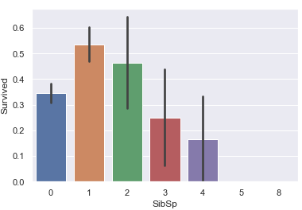
DATA VISUALIZATION
Comparing SibSp with Survived

Slide 14
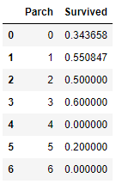
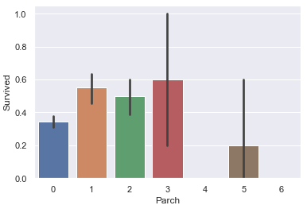
DATA VISUALIZATION
Comparing Parch with Survived

Slide 15
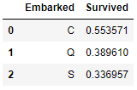
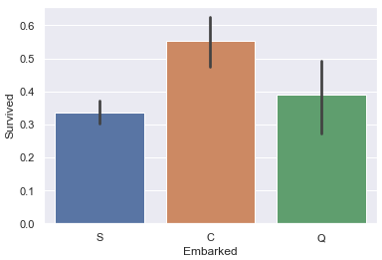
DATA VISUALIZATION
Comparing Embarked with Survived

Slide 16


DATA VISUALIZATION
Checking Max, Min, Mean, Mode
For Fare:
For Age:

Slide 17
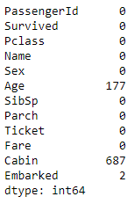
DATA VISUALIZATION
Checking for null values
From this data we get that there are 177 null values in age column and 2 null in embarked column. The data of the cabin is not useful thus, we will exclude that.

Slide 18

DATA VISUALIZATION
The Survived column is dependent upon the Age and Embarked column. They contain some null values, to remove the null value we are filling mean in Age column and S in Embarked column because the occurrence of S is more in the Embarked column. We are filling this to utilize the whole data given in the dataset.

Slide 19
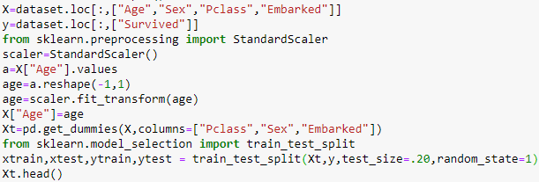
SPLITING DATA FOR TESTING AND TRAINING
From the data visualization, there are four main columns where the output depends upon. Age, Sex, P-class, Embarked. These features are stored in the X list and survived is stored in y.

Slide 20
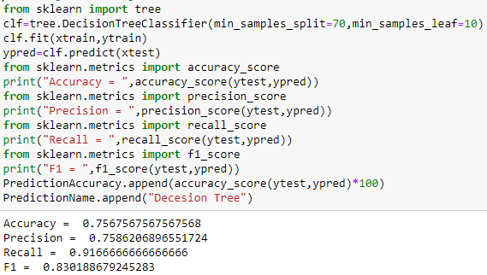
Training and Testing Data using Decision Tree

Slide 21
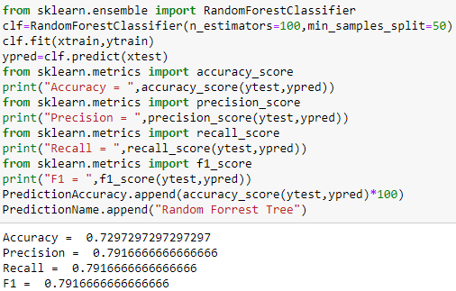
Training Data using Random Forest Classifier

Slide 22
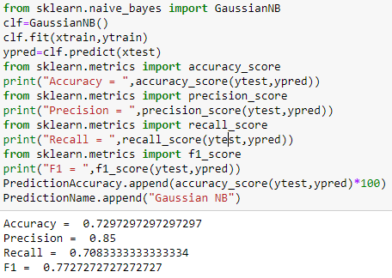
Training Data using GaussianNB

Slide 23
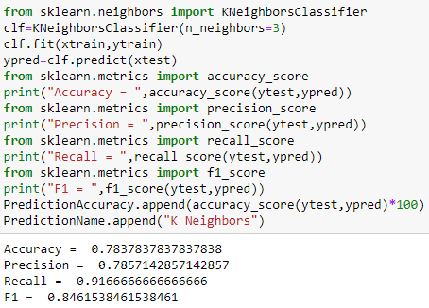
Training Data using KNeighborsClassifier

Slide 24
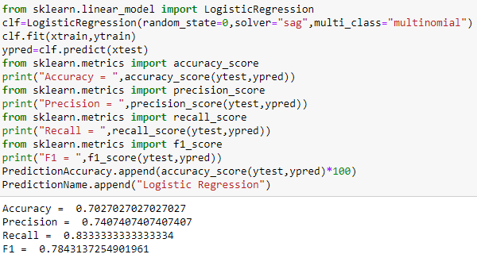
Training Data using LogisticRegression

Slide 25
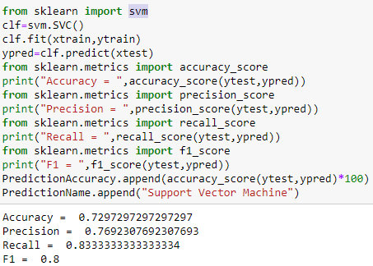
Training Data using Support Vector Machines

Slide 26
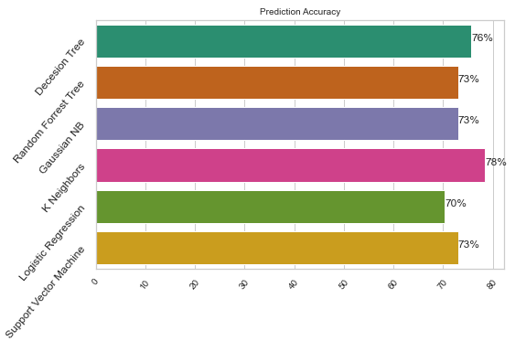
COMPARING MODELS
Comparing all the models with there accuracy

Slide 27
CONCLUSION
While comparing some predicting models we can say that Knieghbors is the best model for this dataset which provides 78% of accuracy which is more than other models.
No algorithm can predict with 100% accuracy.
Comparing all the columns we get that the Women, children, first-class passengers as well as people with the small family had a better chance at survival.

Slide 28
REFRENCES
GeeksforGeeks.org for python guidelines.
Quora.com for assistance in Machine Learning codes.
Numpy.org and matplotlip.org for complete knowledge about the libraries

Slide 29
THANK YOU

